Slide 1
DSA0199- Object oriented analysis using c++
Cybersecurity Threat Detection
PRESENTED BY
G.R.shanmukha(19210085)
E.Sai kumar(192211632)

Slide 2


Cybersecurity Threat Detection
As cyber threats continue to evolve, traditional security approaches are becoming increasingly inadequate. AI-driven cybersecurity solutions offer a powerful new frontier, enabling real-time threat detection, automated incident response, and predictive analytics to stay ahead of emerging risks.

Slide 3

The Evolving Cybersecurity Landscape
1
Sophisticated Attacks
2
Expanding Attack Surface
3
Regulatory Compliance
Cybercriminals are deploying advanced techniques like ransomware, phishing, and zero-day exploits to breach even the most robust defenses.
The proliferation of IoT devices, cloud infrastructure, and remote work has dramatically expanded the attack surface, creating new vulnerabilities.
Stringent data privacy and security regulations require organizations to enhance their cybersecurity posture and demonstrate robust protective measures.

Slide 4
Limitations of Traditional Security Approaches
Reactive Approach
Overwhelming Alert Volumes
Lack of Contextual Understanding
Conventional security tools rely on predefined rules and signatures, leaving them unable to detect novel threats and zero-day attacks.
Security teams are often overwhelmed by the sheer volume of alerts, making it challenging to prioritize and respond effectively.
Traditional systems lack the ability to understand the context and intent behind cyber incidents, leading to high false-positive rates.

Slide 5


The Power of Machine Learning in Threat Detection
Anomaly Detection
Predictive Analytics
ML models can identify unusual patterns and behaviors that indicate potential threats, enabling early detection and prevention.
By analyzing vast datasets, AI-powered systems can forecast emerging threats and help organizations proactively mitigate risks.
Automated Response
Continuous Learning
AI-driven security solutions can swiftly respond to incidents, initiating containment, remediation, and recovery actions with minimal human intervention.
AI systems can continuously learn from new data and evolving threat patterns, adapting their detection models to stay ahead of the curve.

Slide 6


Anomaly Detection: Identifying Unusual Patterns
1
Baseline Modeling
AI models establish a baseline of normal user and system behavior to detect deviations that may indicate a threat.
2
Behavioral Analysis
Machine learning algorithms analyze user activities, network traffic, and other data points to identify abnormal patterns.
3
Adaptive Thresholds
The system dynamically adjusts its detection thresholds to minimize false positives and accurately flag genuine security incidents.

Slide 7
Predictive Analytics: Forecasting Emerging Threats
Big Data Processing
Threat Intelligence
Proactive Strategies
AI-powered systems ingest and analyze vast datasets from various sources to uncover hidden patterns and correlations.
Machine learning models integrate external threat intelligence feeds to enhance their understanding of evolving cyber risks.
By anticipating emerging threats, organizations can implement preventive measures and allocate resources more effectively.

Slide 8


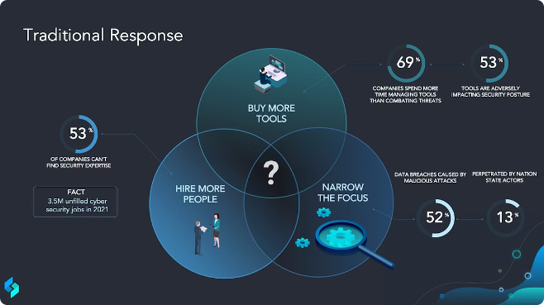


Automated Incident Response: Accelerating Mitigation
Rapid Detection
AI-driven systems rapidly identify and triage security incidents, minimizing the time between threat detection and mitigation.
Automated Workflows
AI-powered security solutions can automatically orchestrate and execute incident response actions, such as containment and remediation.
Human-in-the-Loop
Security analysts are empowered to focus on high-level decision-making, while AI handles the time-consuming, repetitive tasks.

Slide 9





Integrating with Security Operations
Data Integration
Automation
Collaboration
Continuous Improvement
Seamless integration of disparate data sources to provide a comprehensive view of the security landscape.
AI-driven workflows that streamline security operations and reduce the burden on human analysts.
Facilitation of cross-functional teamwork and information sharing for a more holistic security approach.
Ongoing refinement of AI models and security strategies based on feedback and evolving threat landscapes.

Slide 10


Ethical Considerations and Responsible AI Implementation
1
Transparency and Explainability
2
Privacy and Data Protection
Implementing robust data privacy measures and adhering to regulations to protect sensitive information and individual privacy.
Ensuring AI-powered security solutions are transparent and their decision-making processes are explainable to build trust and accountability.
3
Bias Mitigation
4
Human Oversight
Proactively identifying and addressing potential biases in AI models to prevent unintended discrimination and disparate impacts.
Maintaining human oversight and the ability to override AI-driven decisions to ensure ethical and responsible implementation.

Slide 11

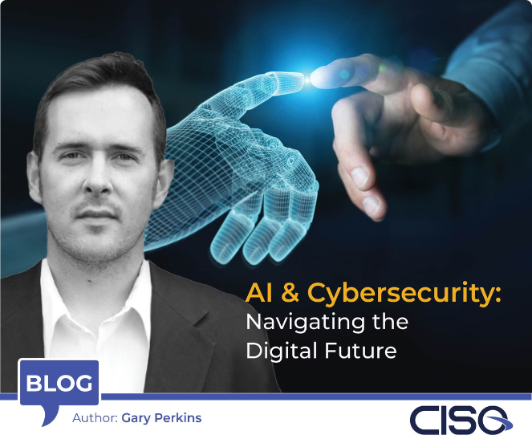
The Future of Cybersecurity: Trends and Outlook
Advanced Threat Detection
Leveraging deep learning and neural networks to identify complex, multi-stage attacks.
Autonomous Response
AI-driven systems that can autonomously initiate containment, remediation, and recovery actions.
Predictive Risk Modeling
Sophisticated predictive analytics to forecast and mitigate emerging cyber risks.
Human-AI Collaboration
Seamless integration of AI capabilities with human expertise for enhanced security operations.

Slide 12
THANK YOU

